Slide 1


Network Topology

Slide 2
Types of Networks
Local Area Networks
Metropolitan Area Networks
Wide Area Networks
Wireless Networks
Home Networks
There are many different types of network, which can be used for different purposes and by different types of
people and organization. Here are some of the networks
32

Slide 3
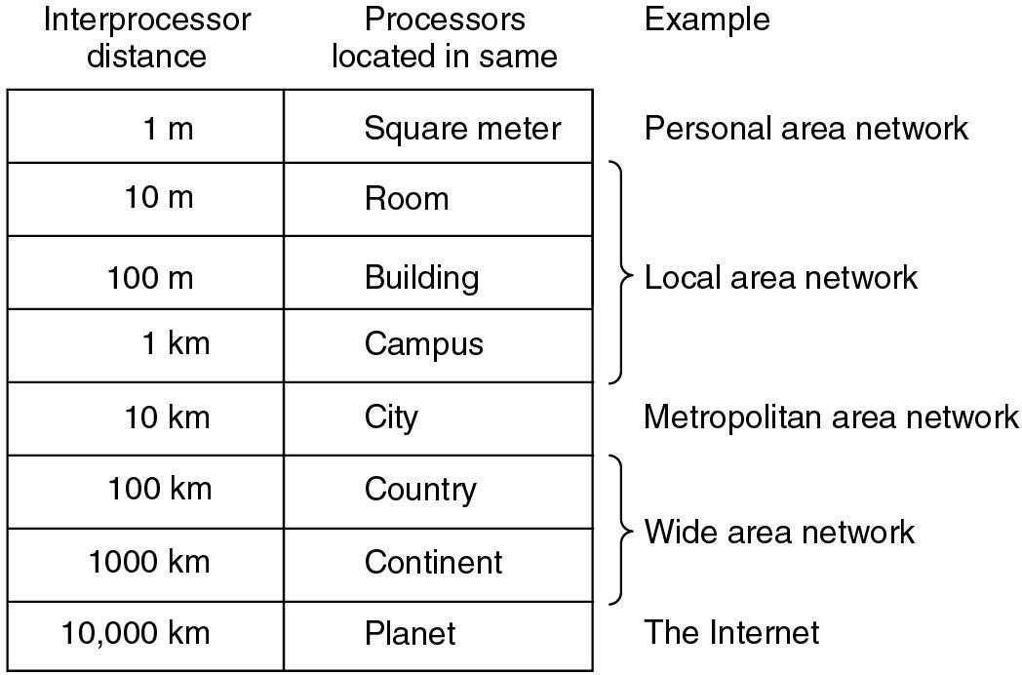
Classification of interconnected processors by scale

Slide 4
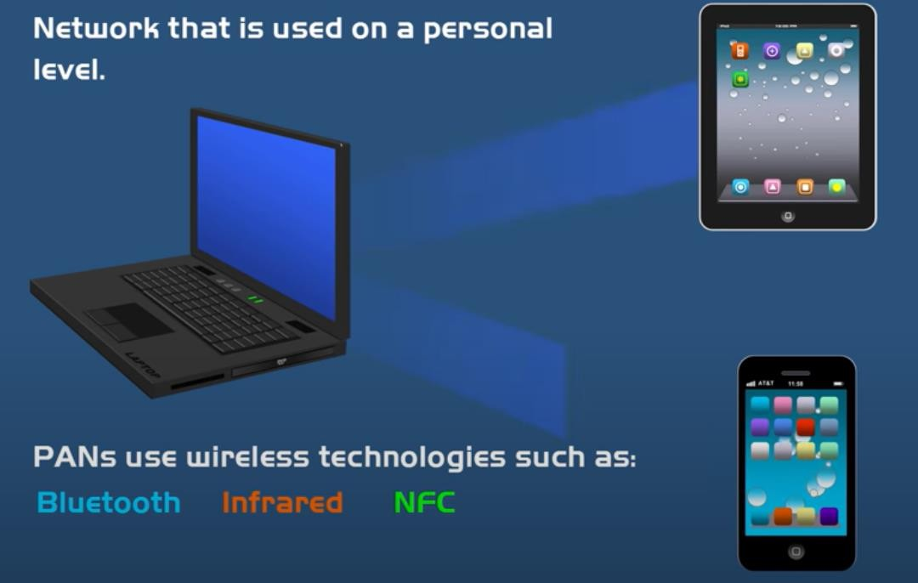
Personal Area Network ( PAN)

Slide 5
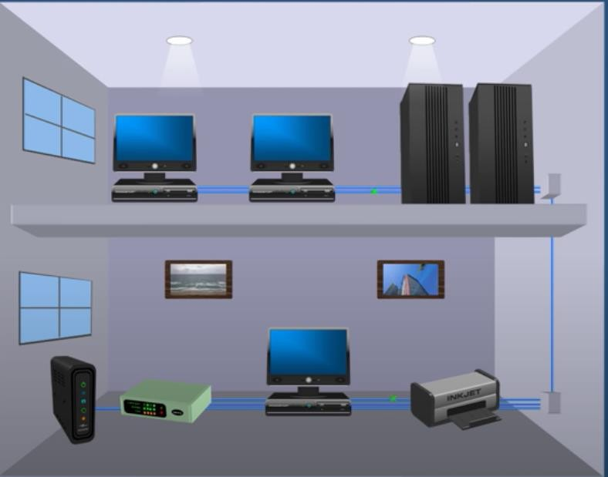
Local Area Networks (LANs)
Group of devices (computers servers, printers , switches etc located in the same building
In close proximity to each other
Most common type of LAN is ethernet LAN
Courtesy: powerCert Animation Videos

Slide 6
Local Area Networks
Characteristics of LAN
small size
transmission technology
single cable
10Mbps ~ 10Gb/s
topology:
bus
Ethernet (IEEE 802.3): 10 or 100 Mbps (10Gb/s)
ring
IBM token ring (IEEE 802.5): 4 or 16 Mbps
IEEE 802 is a collection of networking standards that cover the physical and data-link layer specifications for technologies such as Ethernet and wireless
Channel allocation of broadcast networks
static: each machine has an allocated time slot
dynamic
37

Slide 7
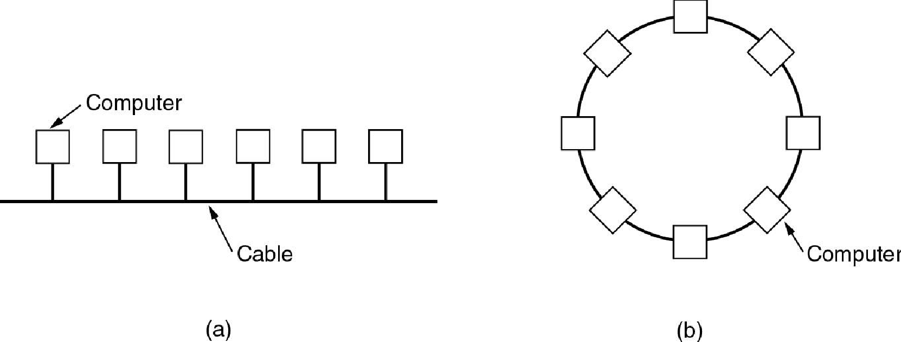
Local Area Networks (LANs)
A local area network or LAN is a network that connects computers within a limited area. This might be in a
school, an office or even a home.
Ethernets are most popular (up to 10 Gb/s)
(b) Ring

Slide 8
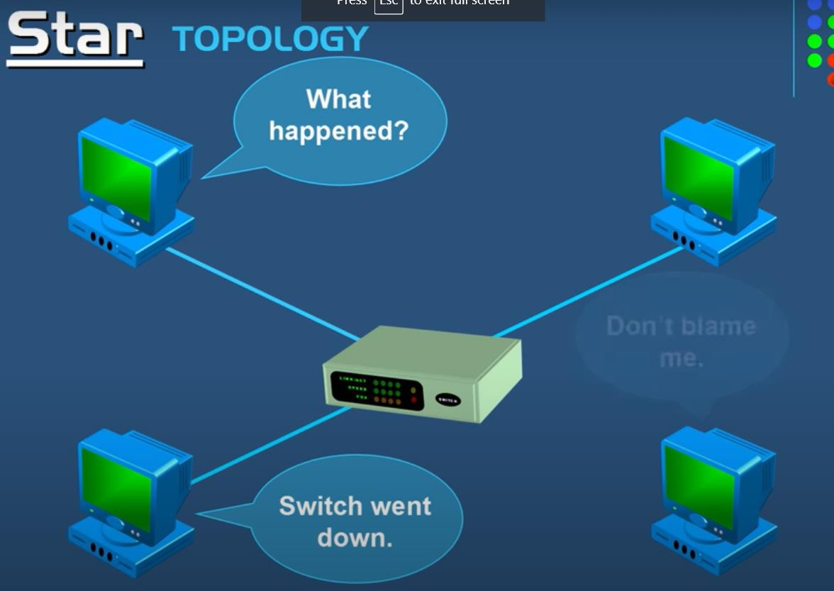
Network Topologies- STAR
Pros
If N devices are connected to each other in star topology, then the number of cables required to connect them is N. So, it is easy to set up.
Each device require only 1 port i.e. to connect to the hub.
Cons
If the concentrator (hub) on which the whole topology relies fails, the whole system will crash down.
Cost of installation is high.
Performance is based on the single concentrator i.e. hub.
Courtesy: powerCert Animation Videos
Notes:
(829) Network Topologies (Star, Bus, Ring, Mesh, Ad hoc, Infrastructure, & Wireless Mesh Topology) - YouTube

Slide 9
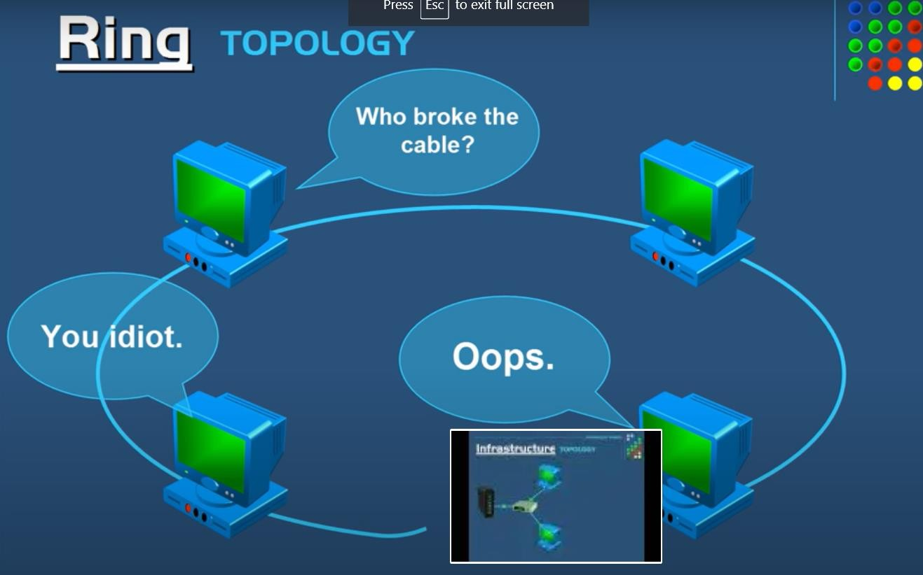
Network Topologies- RING
Advantages of this topology :
All data flows in one direction, reducing the chance of packet collisions.
A network server is not needed to control network connectivity between each workstation.
Data can transfer between workstations at high speeds.
Cheap to install and expand.
Problems with this topology :
If one computer goes wrong all will go wrong
Troubleshooting is difficult in this topology.
Addition of stations in between or removal of stations can disturb the whole topology.
Courtesy: powerCert Animation Videos

Slide 10
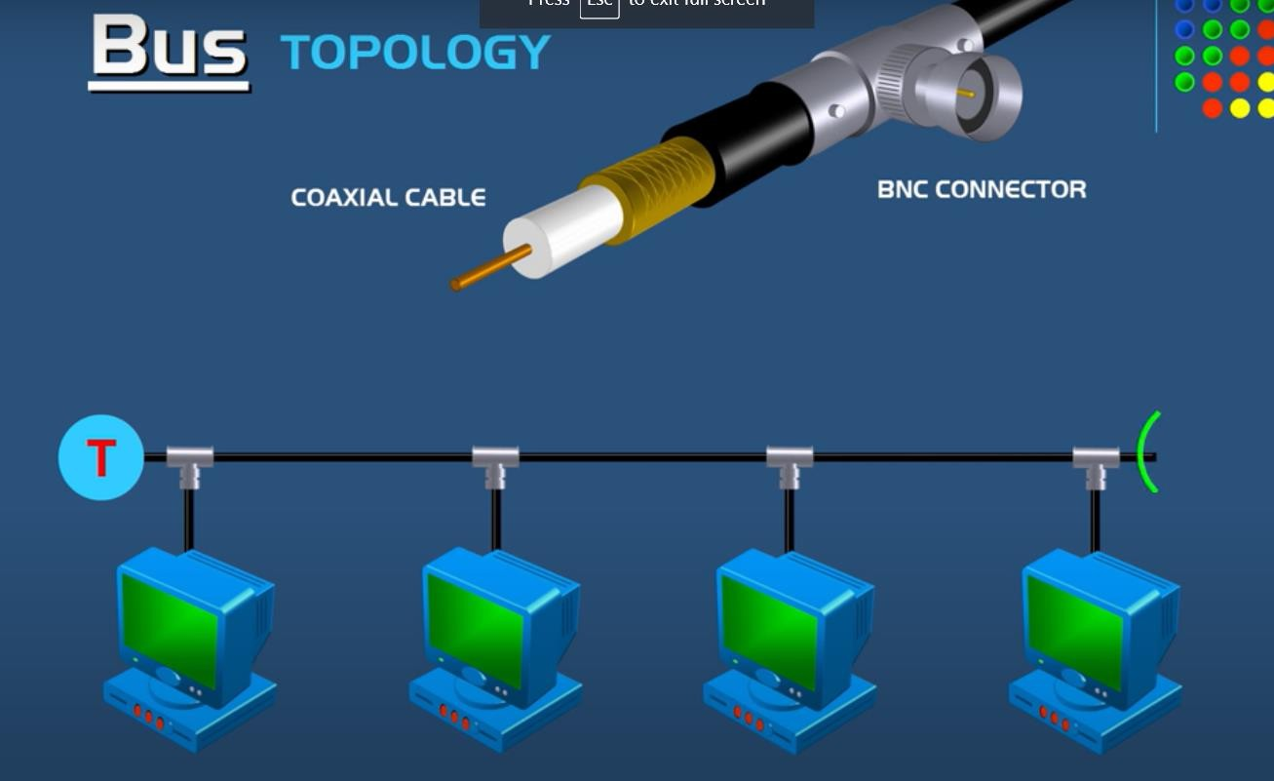
Network Topologies- BUS
Advantages of this topology :
If N devices are connected to each other in bus topology, then the number of cables required to connect them is 1 ?which is known as backbone cable and N drop lines are required.
Cost of the cable is less as compared to other topology, but it is used to built small networks.
Problems with this topology :
If the common cable fails, then the whole system will crash down.
If the network traffic is heavy, it increases collisions in the network..
Terminator gets open data flow disrupted
Courtesy: powerCert Animation Videos

Slide 11
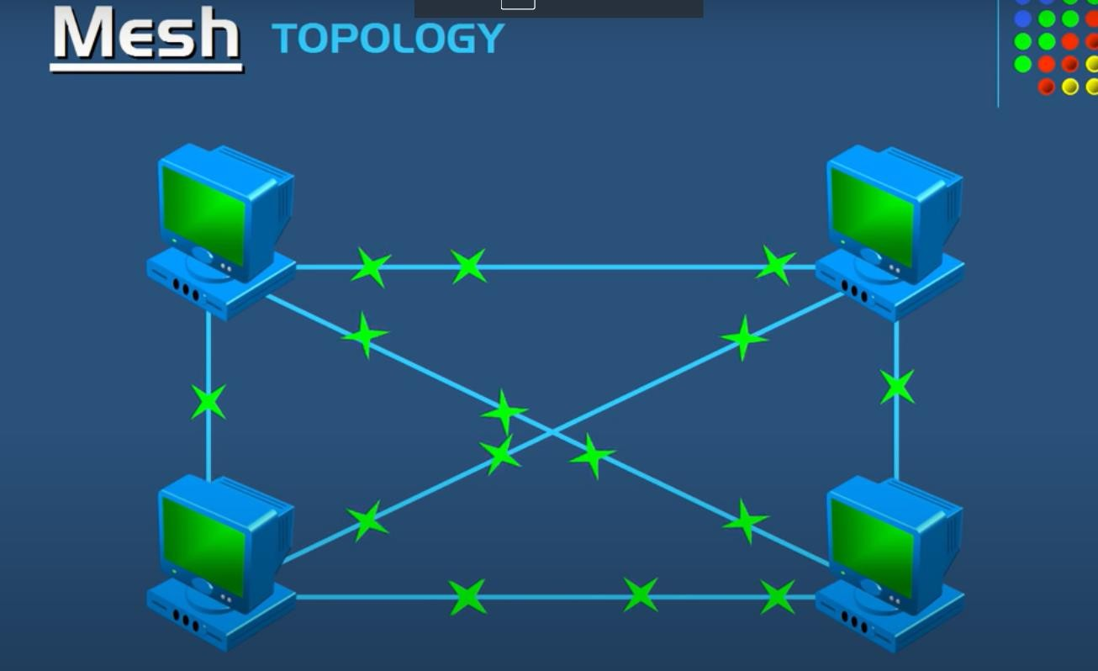
Network Topologies- MESH
Advantages of a mesh topology
Manages high amounts of traffic, because multiple devices can transmit data simultaneously.
A failure of one device does not cause a break in the network or transmission of data.
Adding additional devices does not disrupt data transmission between other devices. Disadvantages of a mesh topology
The cost to implement is higher than other network topologies, making it a less desirable option.
Building and maintaining the topology is difficult and time consuming.
The chance of redundant connections is high, which adds to the high costs and potential for reduced efficiency.
Courtesy: powerCert Animation Videos

Slide 12
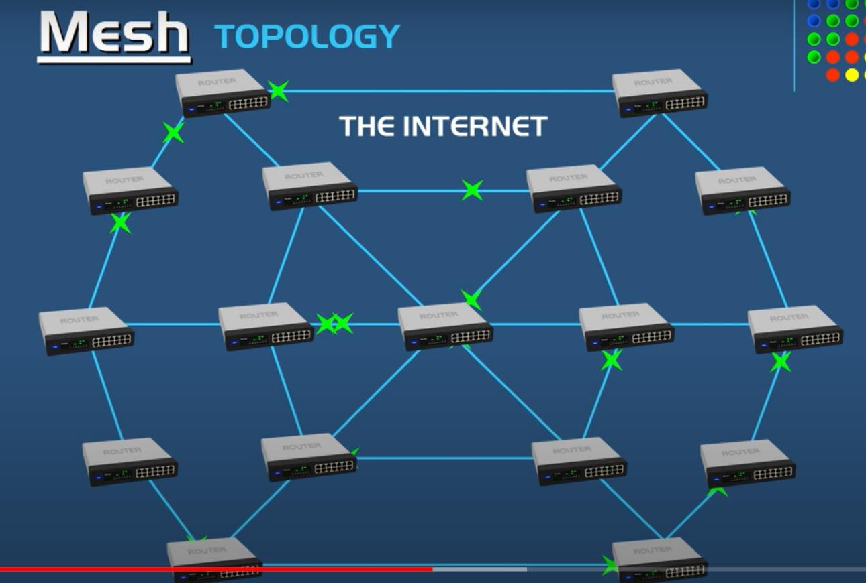
Courtesy: powerCert Animation Videos

Slide 13
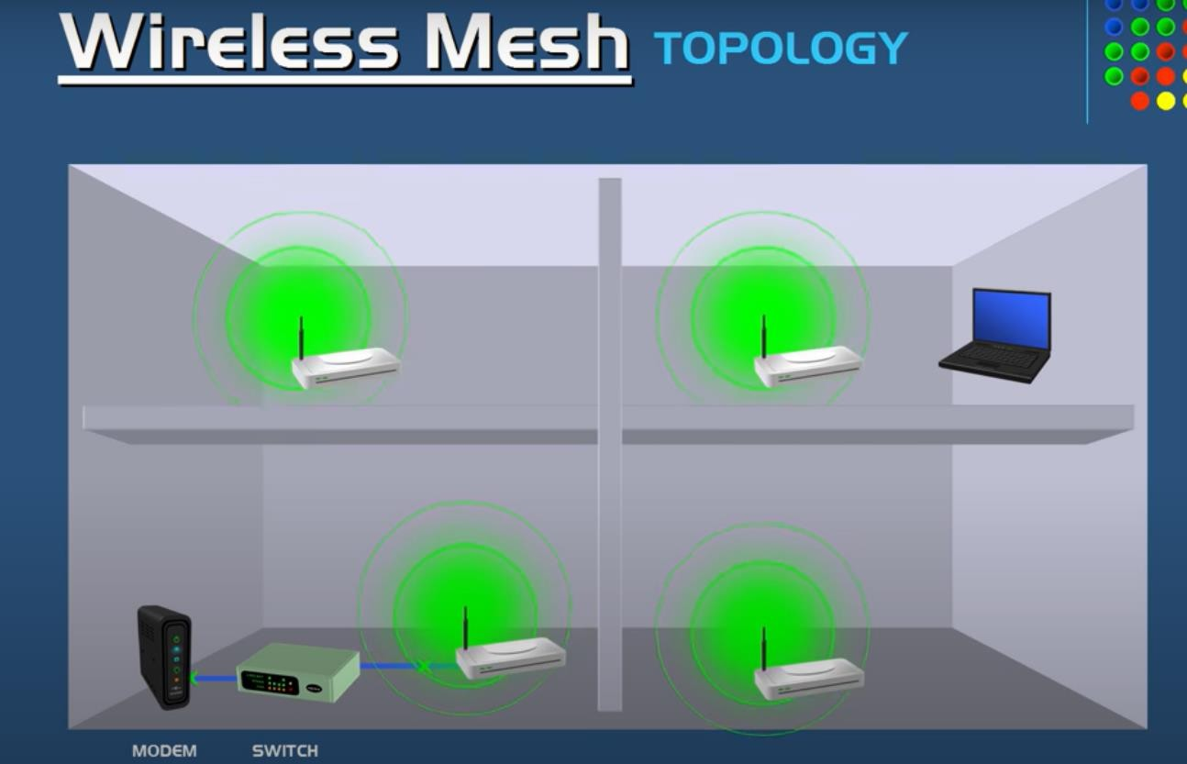
Wireless Topologies
Courtesy: powerCert Animation Videos

Slide 14
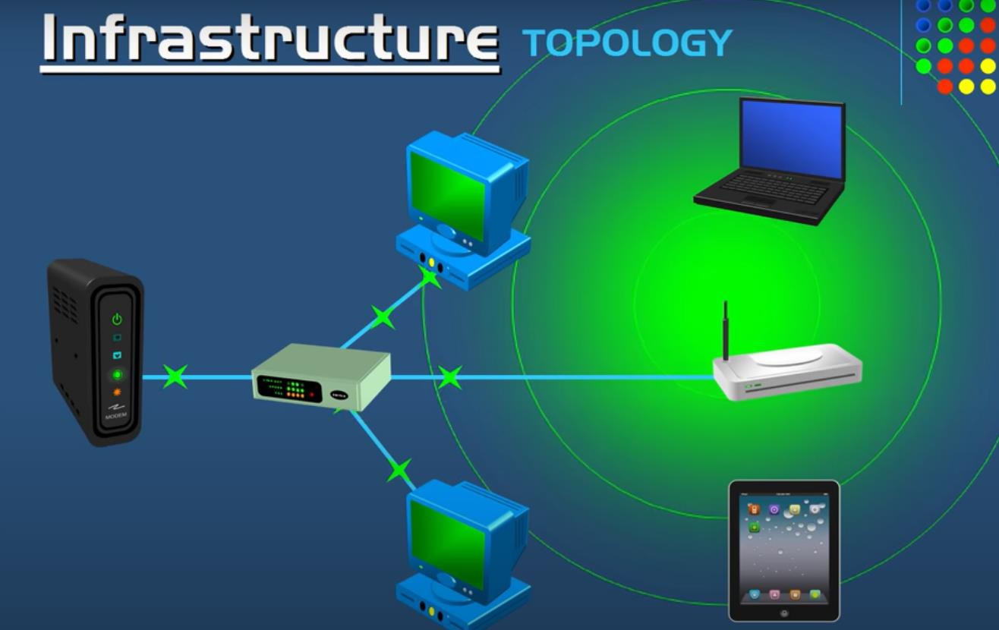
Wireless Topologies

Slide 15
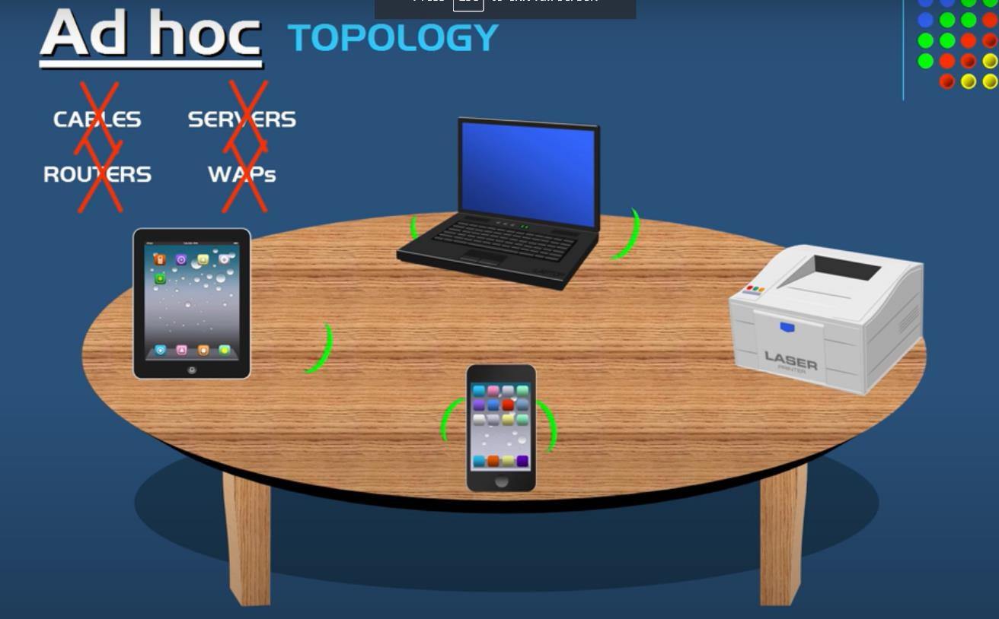
Courtesy: powerCert Animation Videos

Slide 16
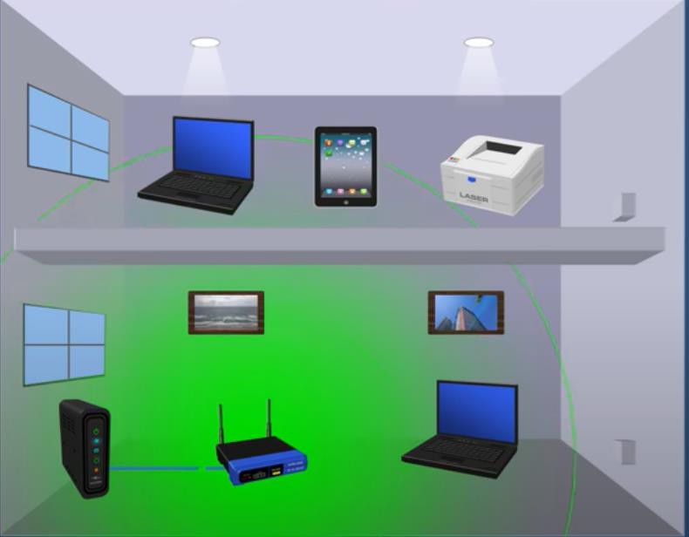
Wireless LAN
Use wireless connection instead of wired
Courtesy: powerCert Animation Videos

Slide 17
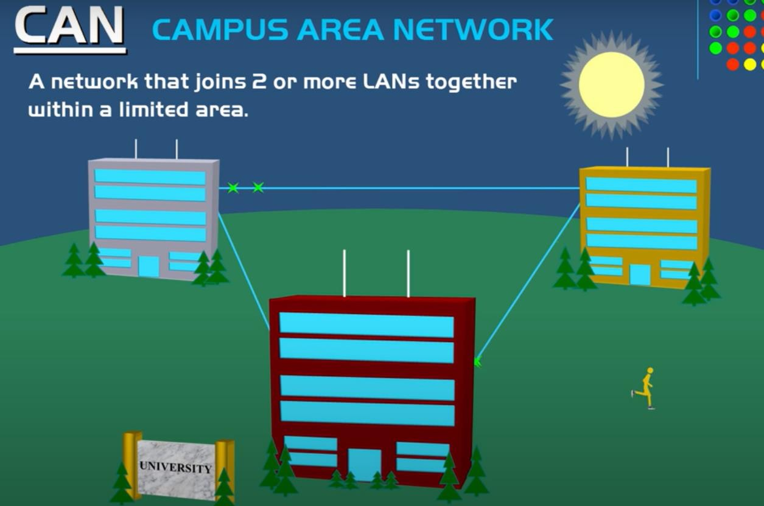

Slide 18
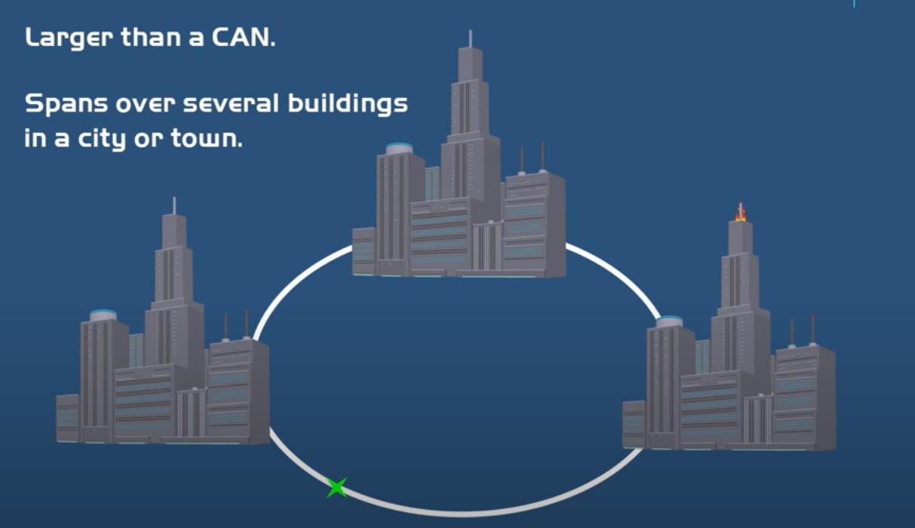
MAN ( Metropolitan Area Network)
Courtesy: powerCert Animation Videos

Slide 19
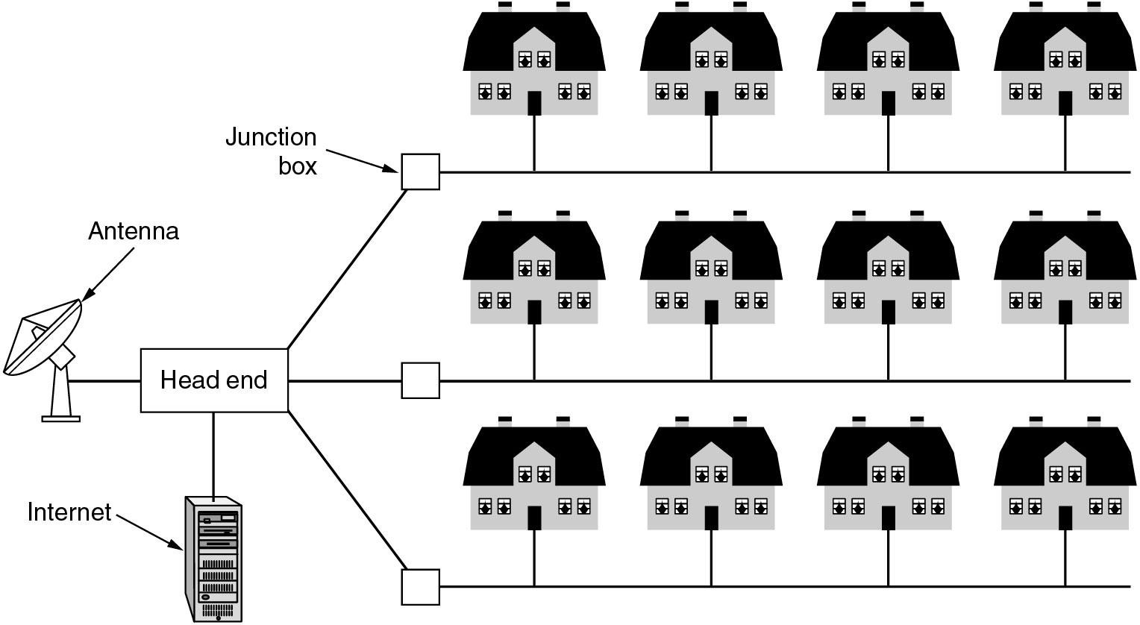
Metropolitan Area Networks
A metropolitan area network based on cable TV.
49

Slide 20
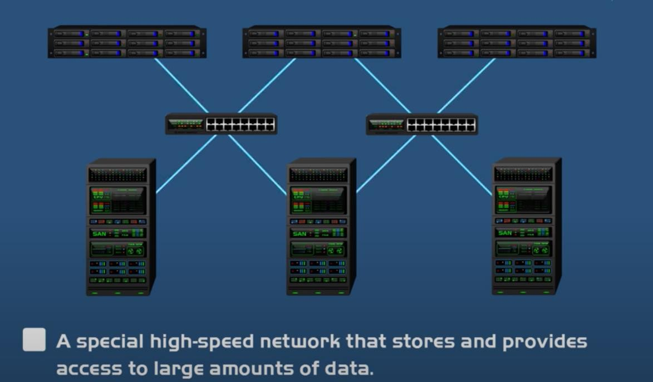
SAN ( Storage Area Network)

Slide 21
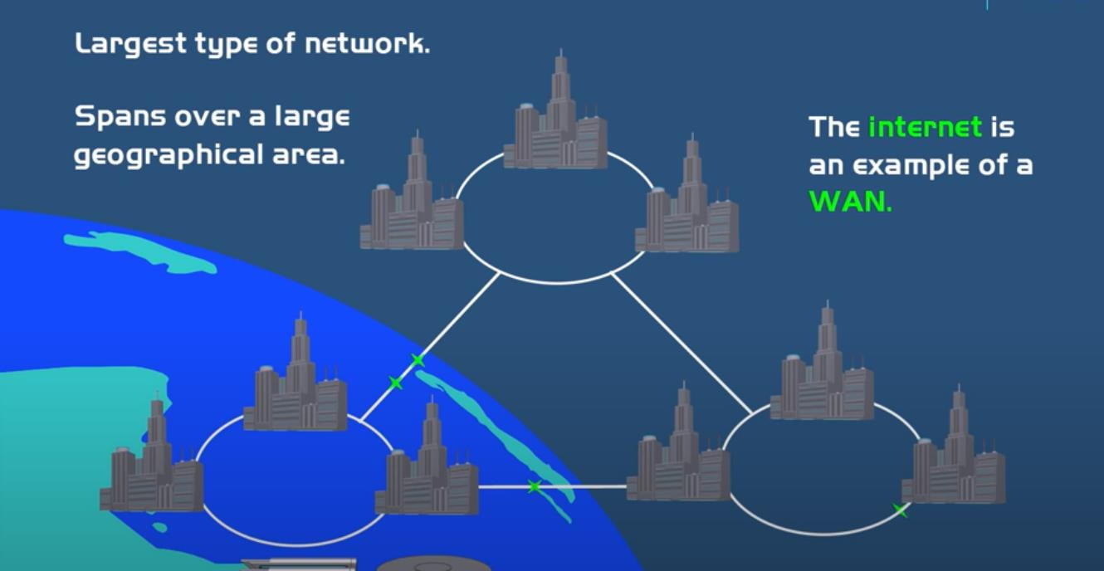
WAN( Wide Area Network)

Slide 22
History of Networking
1969: ARPANET
1970’s: ALOHA, Ethernet, DECNet, SNA
1980’s: Proliferation of LAN (Ethernet, Token Ring)
1987: High speed LAN/MAN (FDDI), BISDN (ATM)
1990: High speed WAN (NSFNET, 45 Mbps)
1993: High speed Ethernet (Fast Ethernet, EtherSwitch)
1996: Interent II (622Mbps)
1998: Gigabit Ethernet
53

Slide 23
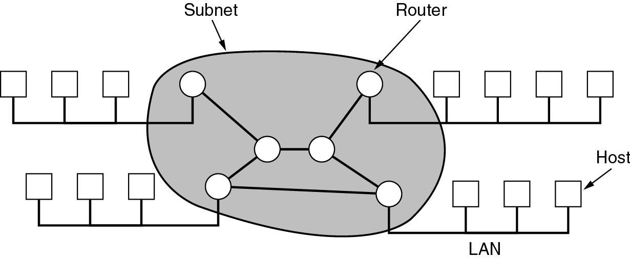
Wide Area Networks (WANs)
WANs are point-to-point networks
WANs consist of two distinct components:
transmission lines (copper, fiber, microwave) and switches (electronics, optics)
⇨ Store-and-forward or packet-switched subnet
Relation between hosts on LANs and the subnet.
52

Slide 24
Wide-Area Wireless Access: 3G 4G and LTE
Wireless infrastructure used for cellular telephony to send/receive packets through a base station that is
operated by the cellular network provider.
iPhones and Android devices are being used to message, share photos in social networks, watch movies, and stream music while on the run
Unlike WiFi, a user need only be within a few tens of kilometers of the base station.
The fourth-generation (4G) of wide-area wireless networks—are already being deployed pretty much
everywhere.
LTE (for “Long-Term Evolution has its roots in 3G technology, and can achieve rates in excess of 10 Mbps.
LTE downstream rates of many tens of Mbps have been reported in commercial deployments
Difference between them is the speed of the network.
When selecting a smartphone, the older models may not support the newer data network technology. It is important to select a model that supports a data speed appropriate for your needs.
Generation of network technology: The third generation network, known as 3G, is the oldest technology of the group. 4G is the fourth generation data network and LTE stands for Long Term Evolution.

Slide 25





